Slide 1

Los Angeles 2016-2018 -------------------- Crime vs POVERTY
Who
Run
the
world?
project
Are there any crime trends?
Does poverty influence crime?

Slide 2





WHO RUN THE WORLD? Team
Ana Davalos
Diana Chacon
Evgeniya Grigoreva
Frances Gliane
Mary Basco

Slide 3

Story
Assumptions
Individuals living in households in Los Angeles, with an income level below the County poverty threshold, have more than double the rate of victim-based crime as compared to individuals in high-income households.
Urban poverty increases the risk of violence and crime for US households.
Los Angeles is one of the biggest cities in the US with one of the highest poverty rates in California.
Poor areas precipitate more crime.
"Poverty is the parent of crime." -Aristotle

Slide 4
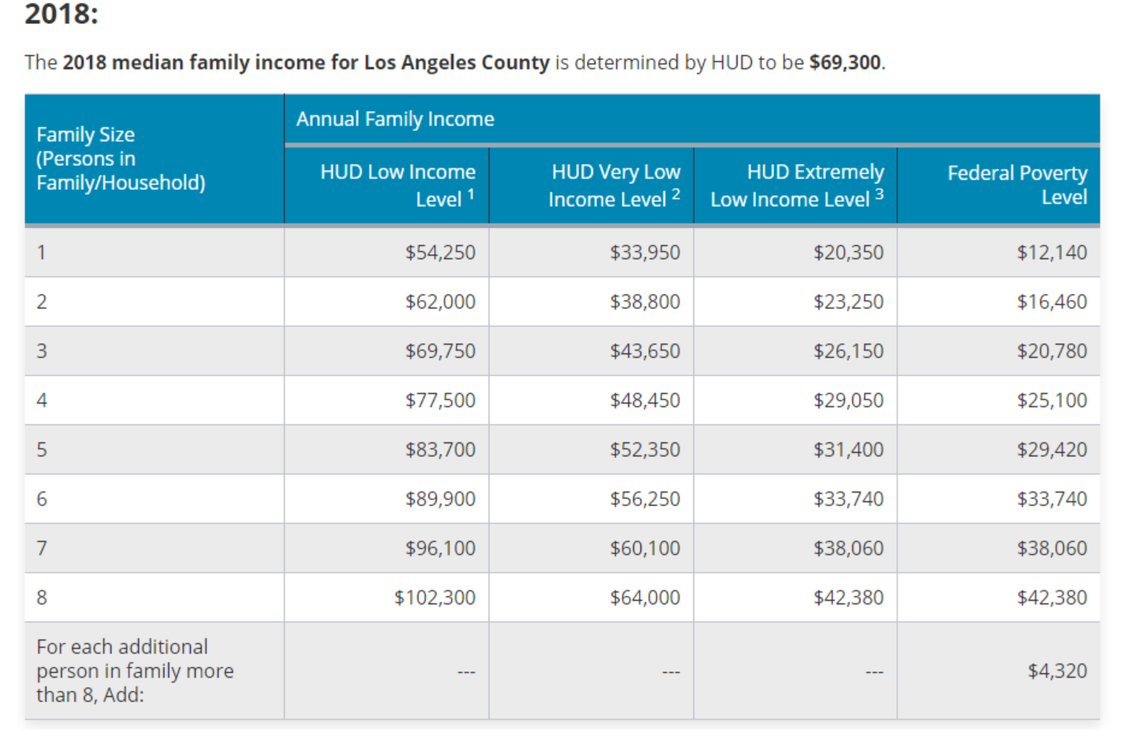
Story
"Poverty is the parent of crime." -Aristotle

Slide 5
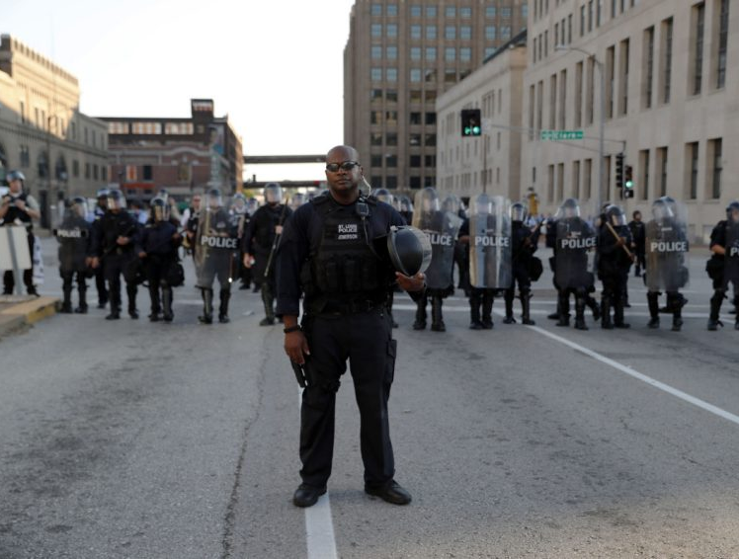
CORE HYPOTHESIS for our project
Will the top 3 crime categories increase over time at the same rate?
Does the majority of criminal activity occur in underprivileged areas?
Does crime behave the same regardless of the day of the week?

Slide 6



Resources
Great data to find great answers
LA Crime Data from 2010 to 2019
https://data.lacity.org/A-Safe-City/Crime-Data-from-2010-to-Present/63jg-8b9z
Census Data
http://census.gov
Google Maps
http://maps.google.com

Slide 7

Crime Data
Historical trends

Slide 8

CRIME DATA
Analysis steps
Results
Find a source file with Crime Data from 2010 to 2019
Identify the crime categories listed on the dataset and combine them into 6
Analyze the historical trends for the top 3 crime categories
Export a *csv file with the last 3 years (2016-2018) for further analysis
Crime Data from 2010 to 2019 *.csv
141 crime categories → 6 categories:
ASSAULT
CRIMINAL THREATS
OTHER
SEX CRIMES
THEFT
VANDALISM

Slide 9
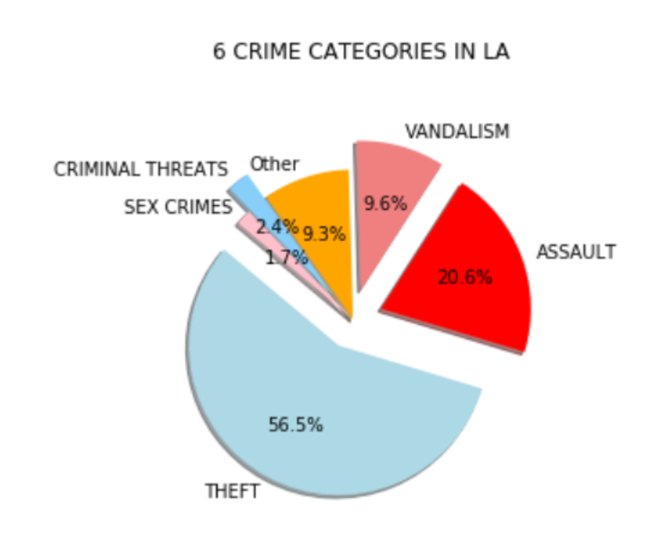
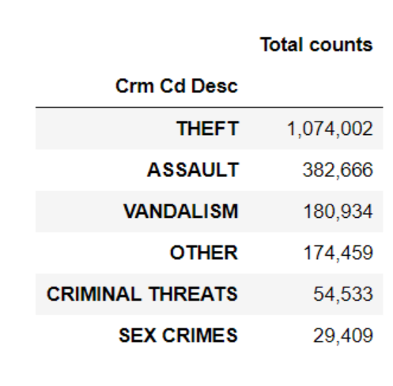
CRIME DATA Analysis Steps. Crimes Categories

Slide 10
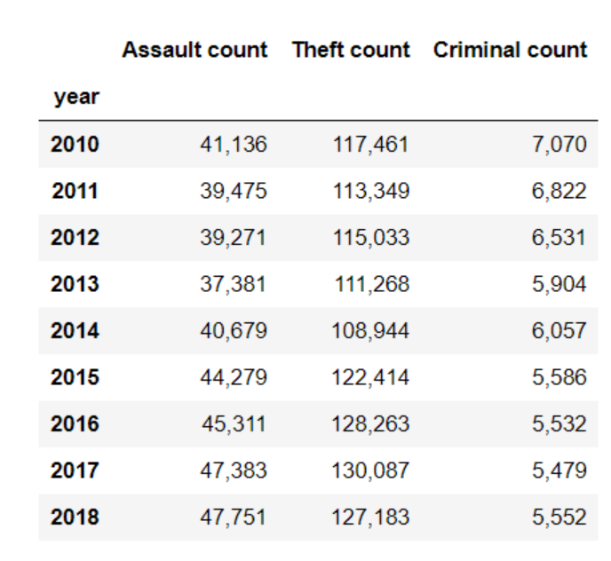
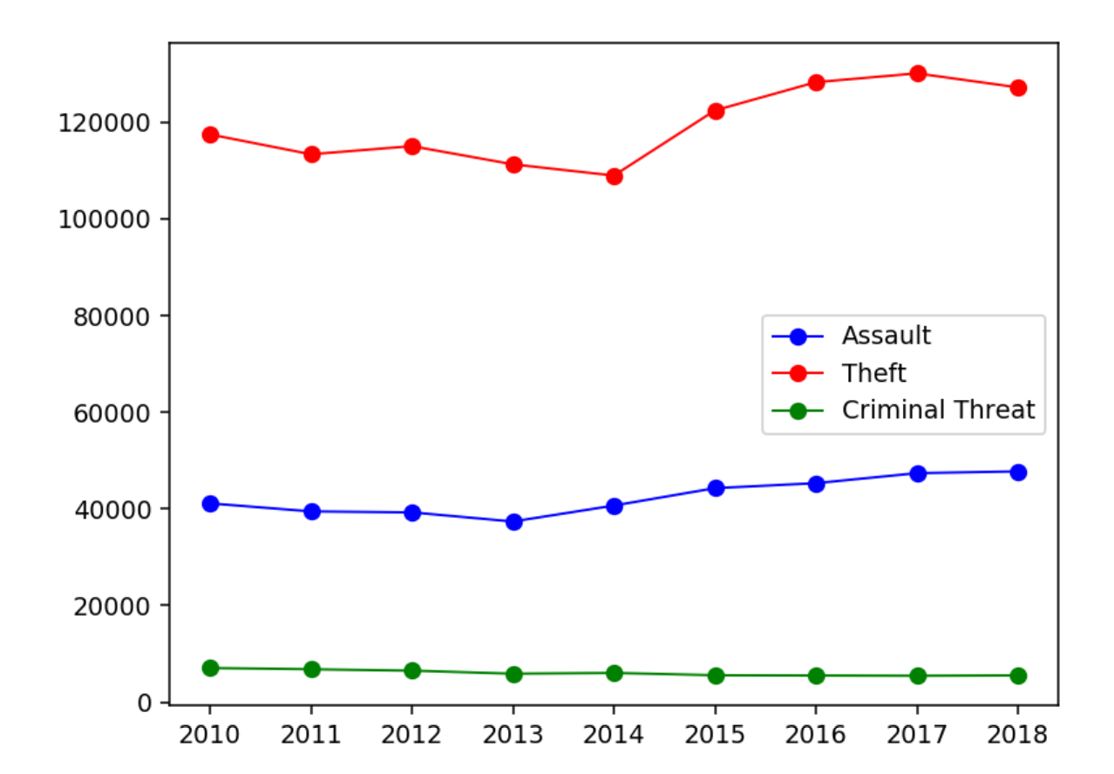
CRIME DATA Analysis Steps. Sample selection - 3 years (2016-2018)

Slide 11
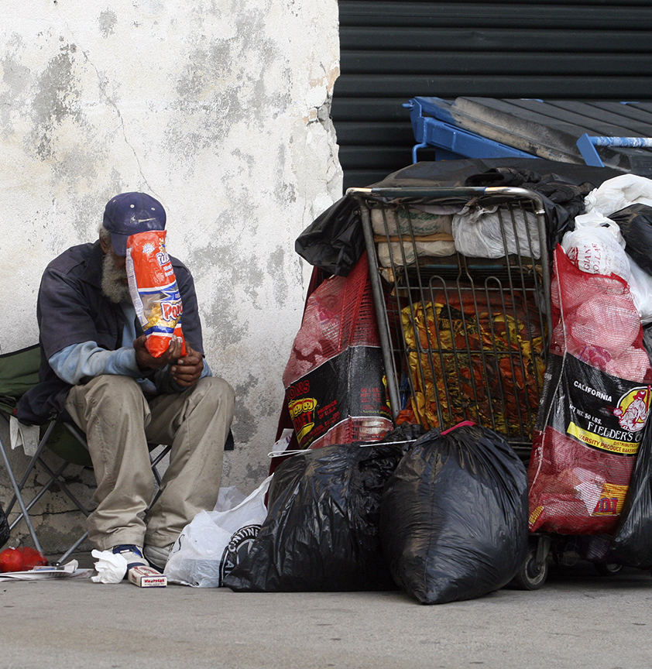
CENSUS Data
FROM Census to POVERTY RATE

Slide 12
CRIME DATA Sample of years
2018
2017
2016

Slide 13
CENSUS DATA
Analysis steps
Results
Find a Python Census Wrapper
Select 3 years (2016-2018) (correlation with Crime Data)
Determine a Poverty Rate
Find LA zip codes
Convert LA zip codes to Latitude, Longitude coordinates
Create a heatmap in Gmaps
Merge all *.csv samples in combined*.csv
Create a scatter plot for 2018
Create a layer for Crime Data, December 2018
Analysis of Frequency of Crimes By Day of Week for 2016-2018
Poverty Rates for different cities in the US
95 zip codes for City of Los Angeles
62 final zip codes with Poverty Rates
Heatmap in Gmaps with 2 layers: Poverty Rate and Crime Layer
Pip install New library PGEOCODE

Slide 14
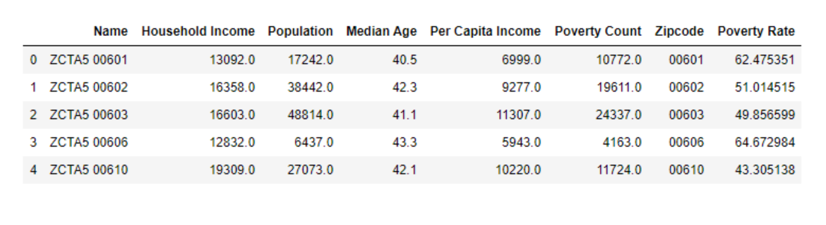
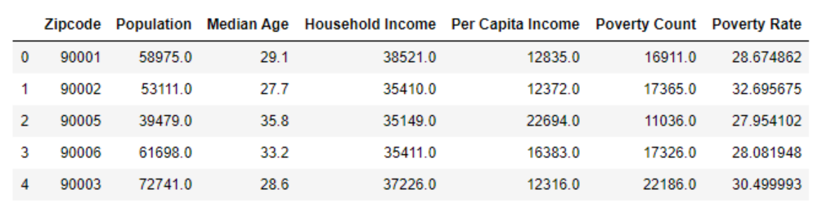
CENSUS DATA Analysis Steps. Poverty Rate for Los Angeles Zip codes

Slide 15
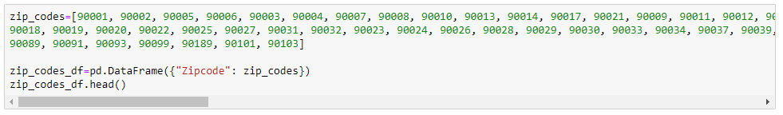
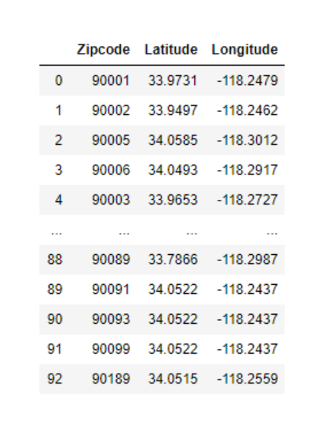
CENSUS DATA Analysis Steps. Zip codes to Latitude-Longitude conversion
Pip install New library PGEOCODE

Slide 16
CENSUS DATA Heatmap for 2016-2018 years
2018
2017
2016

Slide 17
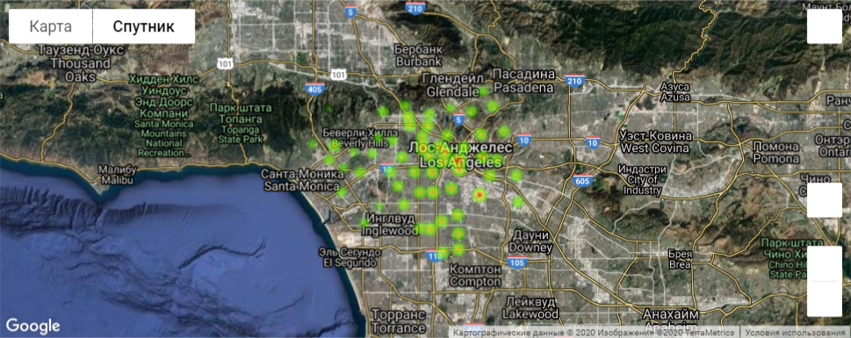
CENSUS DATA Heatmap for 2016. Poverty Rate

Slide 18
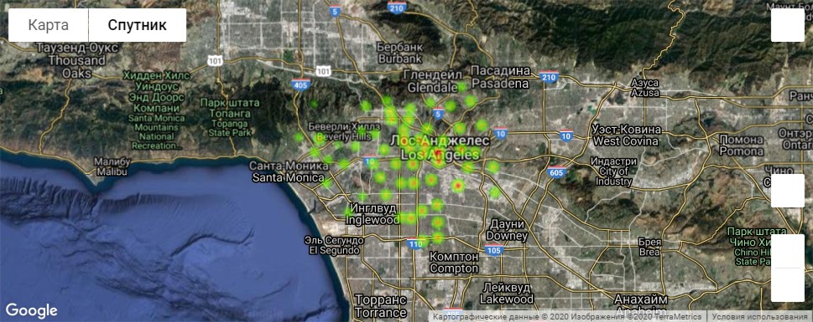
CENSUS DATA Heatmap for 2017. Poverty Rate

Slide 19
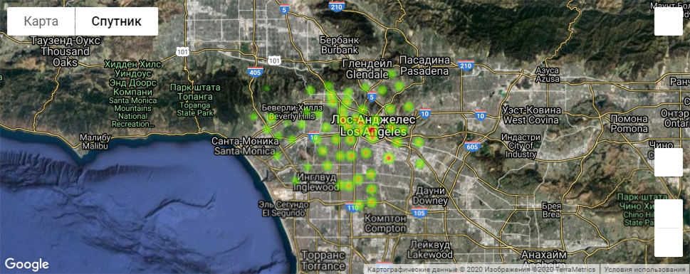
CENSUS DATA Heatmap for 2018. Poverty Rate

Slide 20
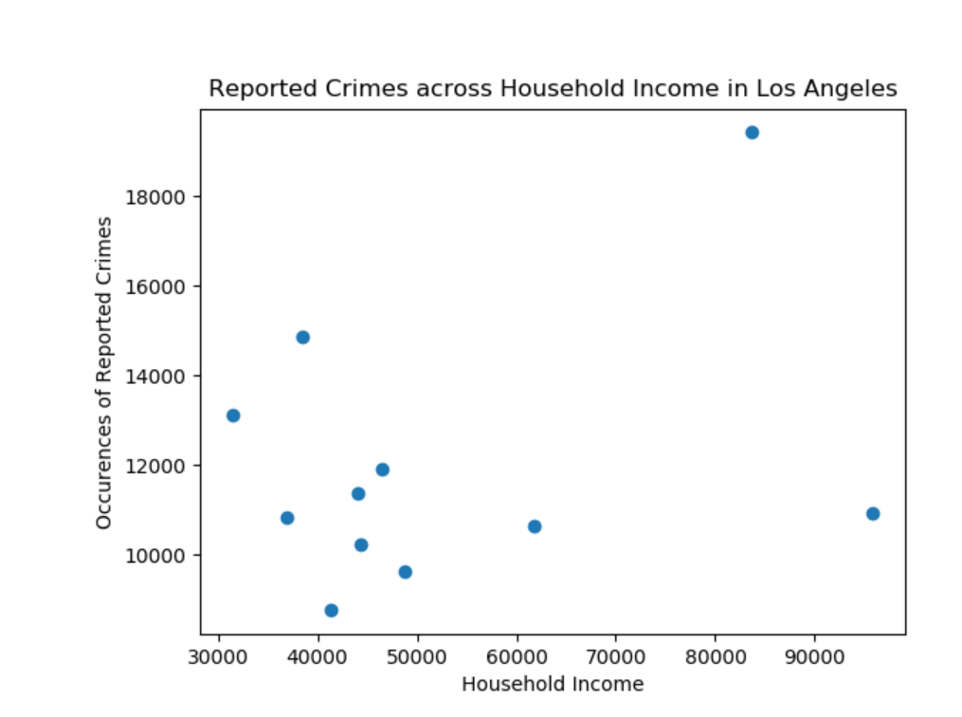
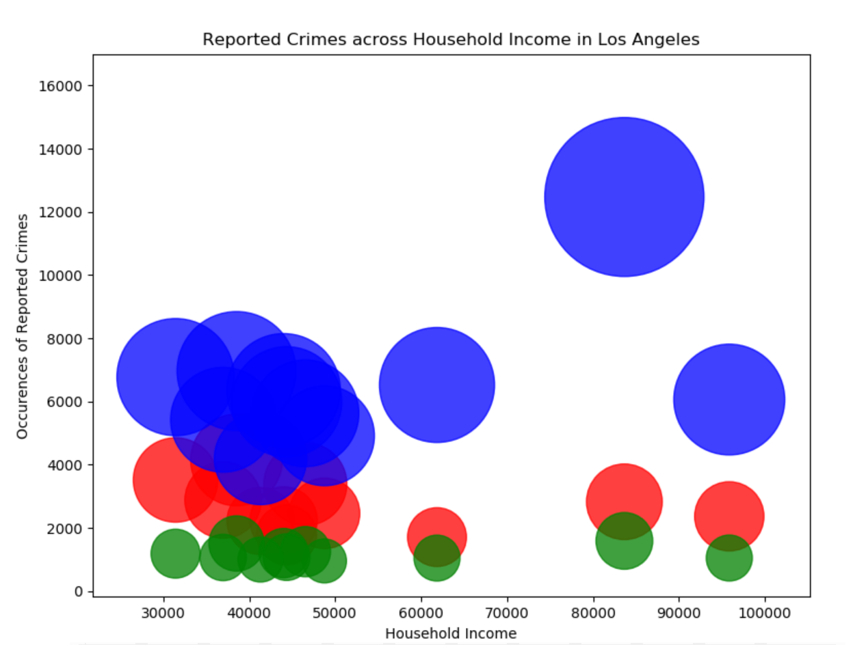

CENSUS DATA Analysis Steps. Reported Crimes across Household income
Average household income = $56,827

Slide 21
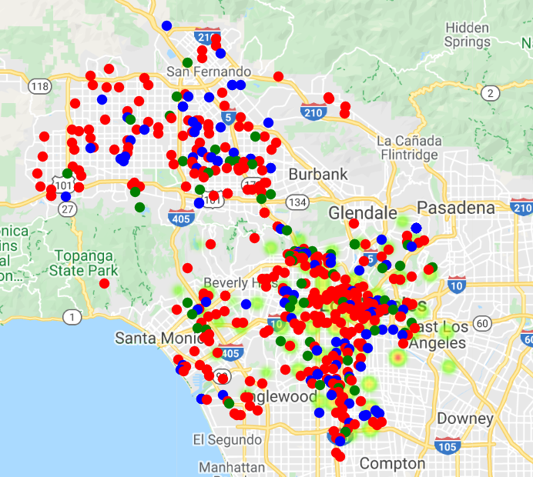
CENSUS DATA Analysis Steps. Crime vs Poverty, December 2018
Poor areas precipitate more crime.

Slide 22
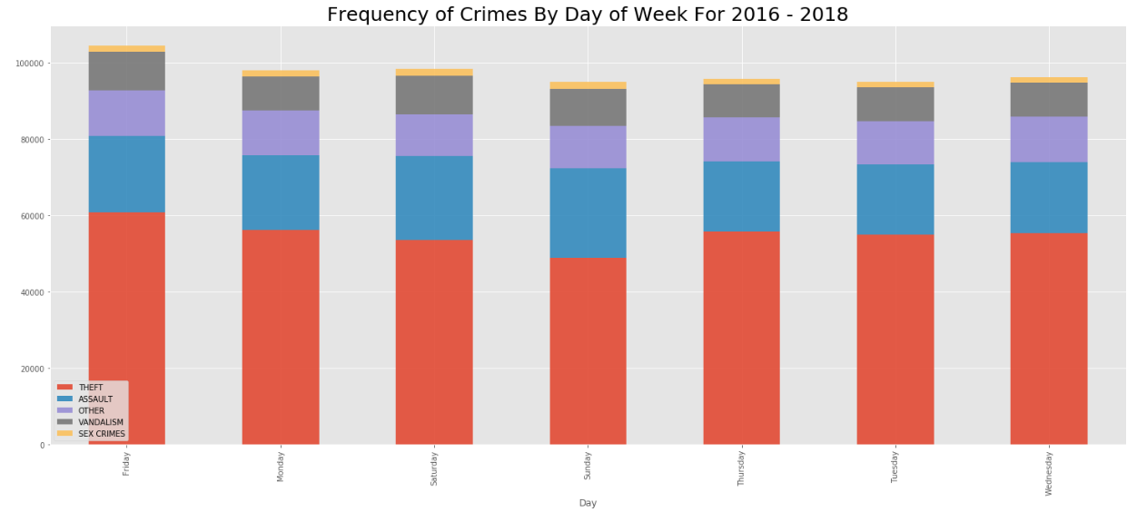
CENSUS DATA Analysis Steps. Frequency of Crimes by Day of Week 2016-2018
Most crimes happen
on Friday
10000
8000
6000
4000
2000
Friday
Monday
Saturday
Sunday
Thursday
Tuesday
Wednesday

Slide 23


Conclusions
Vandalism and Assault categories have similar trends compare to Theft category which is exponentially increased from 108K in 2014 to 130K in 2017
Crimes occur most frequently in communities with the household incomes less than $60000

Slide 24


Questions?
Who Run The World Project Team
https://github.com/dcchacon/WhoRunTheWorldProject

